Slide 1

Spark
Fast, Interactive, Language-Integrated Cluster Computing
Matei Zaharia, Mosharaf Chowdhury, Tathagata Das,
Ankur Dave, Justin Ma, Murphy McCauley, Michael Franklin,
Scott Shenker, Ion Stoica
Derive from a talk by Zaharia but with many edits
UC BERKELEY

Slide 2
History of Hadoop and Spark

Slide 3
Project Goals
Extend the MapReduce model to better support two common classes of analytics apps:
Iterative algorithms (machine learning, graphs)
Interactive data mining
Enhance programmability:
Integrate into Scala programming language
Allow interactive use from Scala interpreter
Also: Java, Python, R
Notes:
Point out that Scala is a modern PL etc
Mention DryadLINQ (but we go beyond it with RDDs)
Point out that interactive use and iterative use go hand in hand because both require small tasks and dataset reuse

Slide 4
Motivation
Most current cluster programming models are based on acyclic data flow from stable storage to stable storage
Map
Reduce
Input
Map
Output
Reduce
Map
Notes:
Acyclic

Slide 5
Motivation
Most current cluster programming models are based on acyclic data flow from stable storage to stable storage
Map
Reduce
Benefits of data flow: runtime can decide where to run tasks and can automatically recover from failures
Input
Map
Output
Reduce
Map
Notes:
Also applies to Dryad, SQL, etc
Benefits: easy to do fault tolerance and

Slide 6
Motivation
Acyclic data flow is inefficient for applications that repeatedly reuse a working set of data:
Iterative algorithms (machine learning, graphs)
Interactive data mining tools (R, Excel, Python)
With current frameworks, apps reload data from stable storage on each query

Slide 7
Solution: Resilient Distributed Datasets (RDDs)
Allow apps to keep working sets in memory for efficient reuse
Retain the attractive properties of MapReduce
Fault tolerance, data locality, scalability
Support a wide range of applications
Notes:
RDDs = first-class way to manipulate and persist intermediate datasets

Slide 8
Programming Model
Resilient distributed datasets (RDDs)
Immutable, partitioned collections of objects
Created through parallel transformations (map, filter, groupBy, join, …) on data in stable storage
Can be cached for efficient reuse
Actions on RDDs
Count, reduce, collect, save, …
More recently:
DataSet and DataFrame instead of RDD
Allows multiple columns
Notes:
You write a single program → similar to DryadLINQ
Distributed data sets with parallel operations on them are pretty standard; the new thing is that they can be reused across ops
Variables in the driver program can be used in parallel ops; accumulators useful for sending information back, cached vars are an optimization
Mention cached vars useful for some workloads that won’t be shown here
Mention it’s all designed to be easy to distribute in a fault-tolerant fashion

Slide 9

Example: Log Mining
Load error messages from a log into memory, then interactively search for various patterns
Base RDD
Cache 1
lines = spark.textFile(“hdfs://...”)
errors = lines.filter(_.startsWith(“ERROR”))
messages = errors.map(_.split(‘\t’)(2))
cachedMsgs = messages.cache()
Transformed RDD
Worker
results
tasks
Block 1
Driver
Action
cachedMsgs.filter(_.contains(“foo”)).count
cachedMsgs.filter(_.contains(“bar”)).count
Cache 2
Worker
. . .
Cache 3
Result: full-text search of Wikipedia in <1 sec (vs 20 sec for on-disk data)
Worker
Block 2
Result: scaled to 1 TB data in 5-7 sec (vs 170 sec for on-disk data)
Block 3
Notes:
Key idea: add “variables” to the “functions” in functional programming

Slide 10
RDD Fault Tolerance
RDDs maintain lineage information that can be used to reconstruct lost partitions
Ex:
messages = textFile(...).filter(_.startsWith(“ERROR”))
.map(_.split(‘\t’)(2))
HDFS File
Filtered RDD
Mapped RDD
filter (func = _.contains(...))
map (func = _.split(...))

Slide 11
Operations on RDDs
Transformations (define a new RDD) | map filter sample groupByKey reduceByKey sortByKey | flatMap union join cogroup cross mapValues
Actions (return a result to driver program) | collect reduce count save lookupKey

Slide 12
Spark Scheduler
Dryad-like DAGs
Pipelines functions within a stage
Cache-aware work reuse & locality
Partitioning-aware to avoid shuffles
A:
B:
G:
Stage 1
groupBy
C:
D:
F:
map
E:
join
Stage 2
union
Stage 3
= cached data partition
Notes:
NOT a modified version of Hadoop

Slide 13
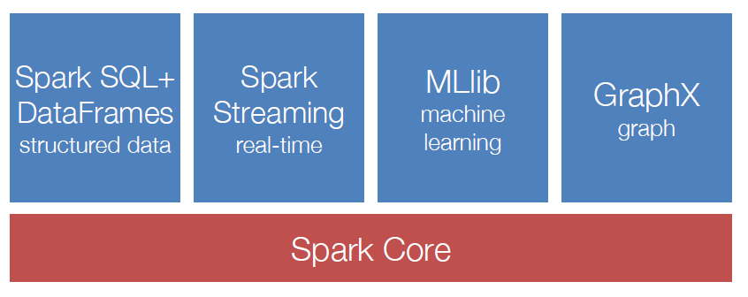
Spark Ecosystem: A Unified Pipeline

Slide 14
Apache Hadoop & Apache Spark
Map Reduce
Hive
Pig
Other Applications
Spark Stream
Spark SQL
Processing
Resource manager
Yet Another Resource Negotiator (YARN)
Mesos etc.
Spark Core
Data Ingestion Systems
e.g., Apache Kafka, Flume, etc
Hadoop Database (HBase)
Cassandra etc., other storage systems
Data Storage
Hadoop Distributed File System (HDFS)
Hadoop
Spark
Notes:
Spark is not, despite the hype, a replacement for Hadoop. Nor mapreduce is dead. Spark can run on top of Hadoop, benefiting from yarn….. And underlying storage HDFS… spark can also run completely separately from Hadoop, integrating with alternative cluster managers like mesos, and alternative storage platforms such as cassandra

Slide 15
Apache Spark
** Spark can connect to several types of cluster managers (either Spark’s own standalone cluster manager, Mesos or YARN)
Processing
Spark Stream
Spark SQL
Spark ML
Other Applications
Resource manager
Spark Core
(Standalone Scheduler)
Mesos etc.
Yet Another Resource Negotiator (YARN)
Data Ingestion Systems
e.g., Apache Kafka, Flume, etc
Data Storage
S3, Cassandra etc., other storage systems
Hadoop NoSQL Database (HBase)
Hadoop Distributed File System (HDFS)
Hadoop
Spark

